Slide 1
Social Networks & Mobile Commerce
Ecommerce SE-413

Slide 2
Importance
E-Commerce businesses can’t afford automatic perception today.
Small Businesses have budget constraints
The Customer is online
57.5% of internet users aged 16 to 64 buy a product or service online weekly

Slide 3
Business Use of SM
Boost brand awareness
Interact more with customers
Address customer needs
Understand market appetite
Analyse consumer sentiment
Product reviews
Rating and review systems

Slide 4
Business Workflow for SM
Define your goals
Drive more traffic
Build an engaged following
Sell % of products directly
Bring traffic to physical store
Find out where the audience “lives”
Create and optimize profiles
Use tools to automate
Interact with and engage your followers

Slide 5
Social Media – Important Stats
Facebook
2.96 billion monthly users. (Sept 22)
80% of Millennials and Gen-Xers. (2019)
70% of people earning more than $75k a year. (US)
98.5% of users access FB via mobile. (Ubiquitous)
People all over the world. (Worldwide reach)

Slide 6
Social Media – Important Stats
Instagram
1.22 billion monthly users. (2021)
More than 30% are Millennials and Gen-Xers. (2021)
70% of people earning more than $75k a year. (US)
1 in 2 people have used Instagram to discover new brands.(2021)
44% of people use Instagram to shop weekly. (2022)

Slide 7
Social Media – Important Stats
Twitter
450 million monthly active users. (2021)
Worldwide, 38.5% of Twitter users are 25-34. (2021)
85% of Twitter’s audience earn more than $30,000
34% earn $75,000 or above. (US)
53% of people on Twitter are more likely to be the first to buy new products. (2017)
59% of brand replies to user Tweets occur within 15 minutes.

Slide 8
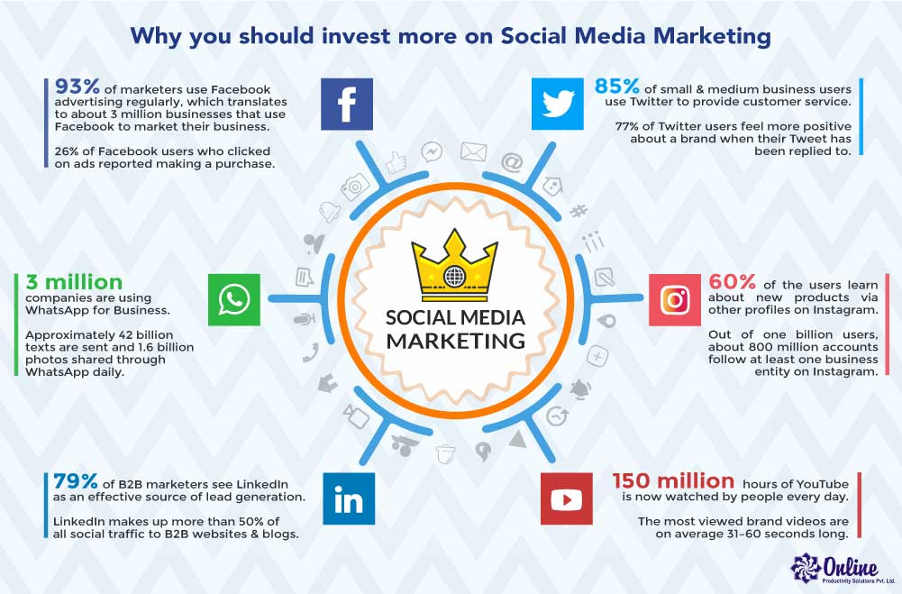
Social Media – Important Stats

Slide 9
Social Commerce
Buying & Selling of products directly on Social Media.
FB Marketplaces, FB/ IG Shops, TikTok Shops, Live Streams.
Needed because
That’s where most of the customers are.
More mobile-based customers. More drop-offs.
Business Need to Simply Conversions.

Slide 10
Social Commerce - Benefits
Reach more potential customers. More easily.
Location, Age, Gender, Habits etc.
Reach. Interact. Convince. Convert.
Using a single platform.
Analytics and business recommendations are much more rich.

Slide 11
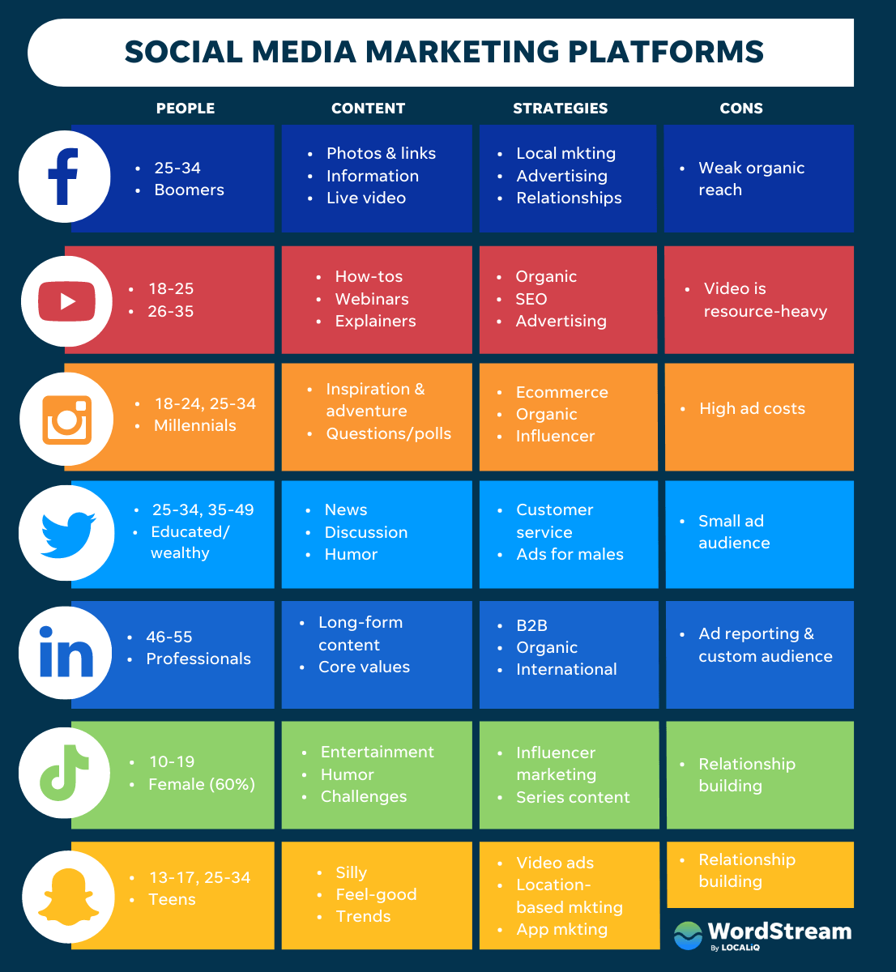

Slide 12
Social Media Tools
Hootsuite
Campaign planning, Ad optimization, Hashtag Monitoring
Buffer
Unified Social Inbox, Location and User Tagging
Sproutsocial
Social CRM, Social Listening, Team Workflows
Sendible
Brand Tracking, Keyword Filtering
Awario
Social Measurement, Sentiment Scoring
Active Chat
Automated Chatbot with AI and Machine Learning
FB Business Manager

Slide 13
Types of Ads on Social Media
https://digivizer.com/blog/social-media-ad-formats-complete-guide-with-examples/

